Slide 1
The Forgotten Year
Applying Lessons from Freshman Success to Sophomore Year
ALEX SEESKIN, SHELBY MAHAFFIE, & ALEX USHER
AUGUST 2020

Slide 2
Introduction
Sophomore year is often overlooked in its importance compared to freshman or junior year, but sophomore year can actually be a valuable time to focus on the rigor of relevant coursework and to imagine a future of post-secondary possibility and adulthood.
Fifteen years ago, the University of Chicago Consortium on School Research found that students’ course performance and credits earned in ninth grade are more predictive of their likelihood of graduating from high school than their race, gender, socioeconomic status, and standardized test scores combined. Students who end freshman year on-track are nearly three times more likely than their off-track peers to graduate from high school.

Slide 3
Introduction
Despite the growth in the Freshman OnTrack rate accelerating, there have always been students who were on-track as freshmen but ultimately did not graduate.
This presentation sheds light on a research-based set of indicators for sophomore year, building from the lessons of the district’s work around Freshman OnTrack, through which sophomore educators can better target intervention and support students in sophomore year.
On their own, indicators can’t and won’t change a system, but our hope is that this research will draw attention to the importance of sophomore year.

Slide 4
Lessons from Freshman Success

Slide 5
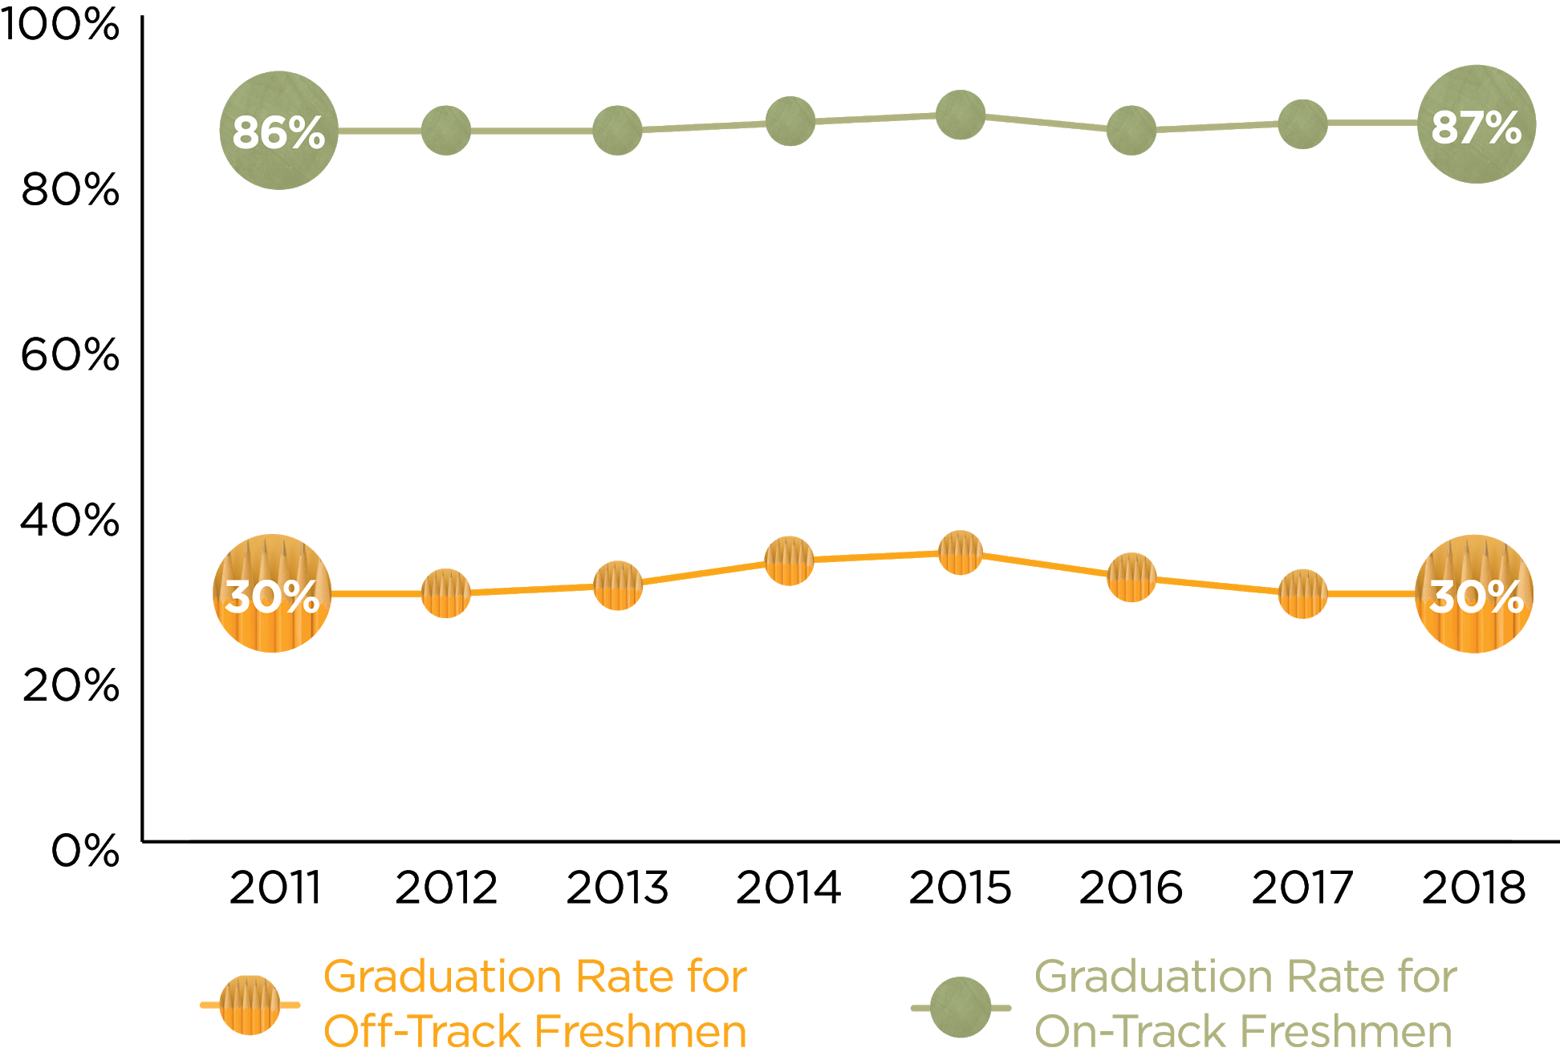
The Freshman OnTrack indicator remains highly predictive of students’ high school outcomes.
Although Freshman OnTrack rates have improved over time, the percentage of on-track freshmen and off-track freshmen who graduate from high school has remained virtually unchanged.
Charter school students are excluded from this analysis. Graduation status is based on whether a student graduated from CPS within four years of starting high school. Diplomas from alternative high schools are not counted towards graduation rates.

Slide 6
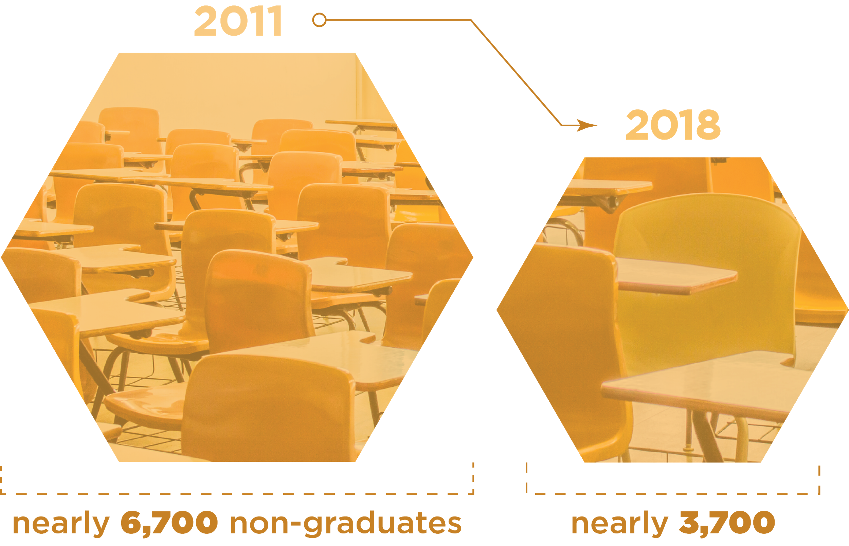
The number of CPS students who did not graduate from high school within four years declined significantly over the past decade.
*In CPS, the number of students in each cohort has declined over time from 20,882 students in 2011 graduation cohort to 17,962 students in 2018. In 2011, 32 percent of students did not graduate within four years of starting high school vs. 21 percent in 2018. The decline in overall enrollment accounts for some of the decline in the number of non-graduates. Charter school students are excluded from this analysis.

Slide 7
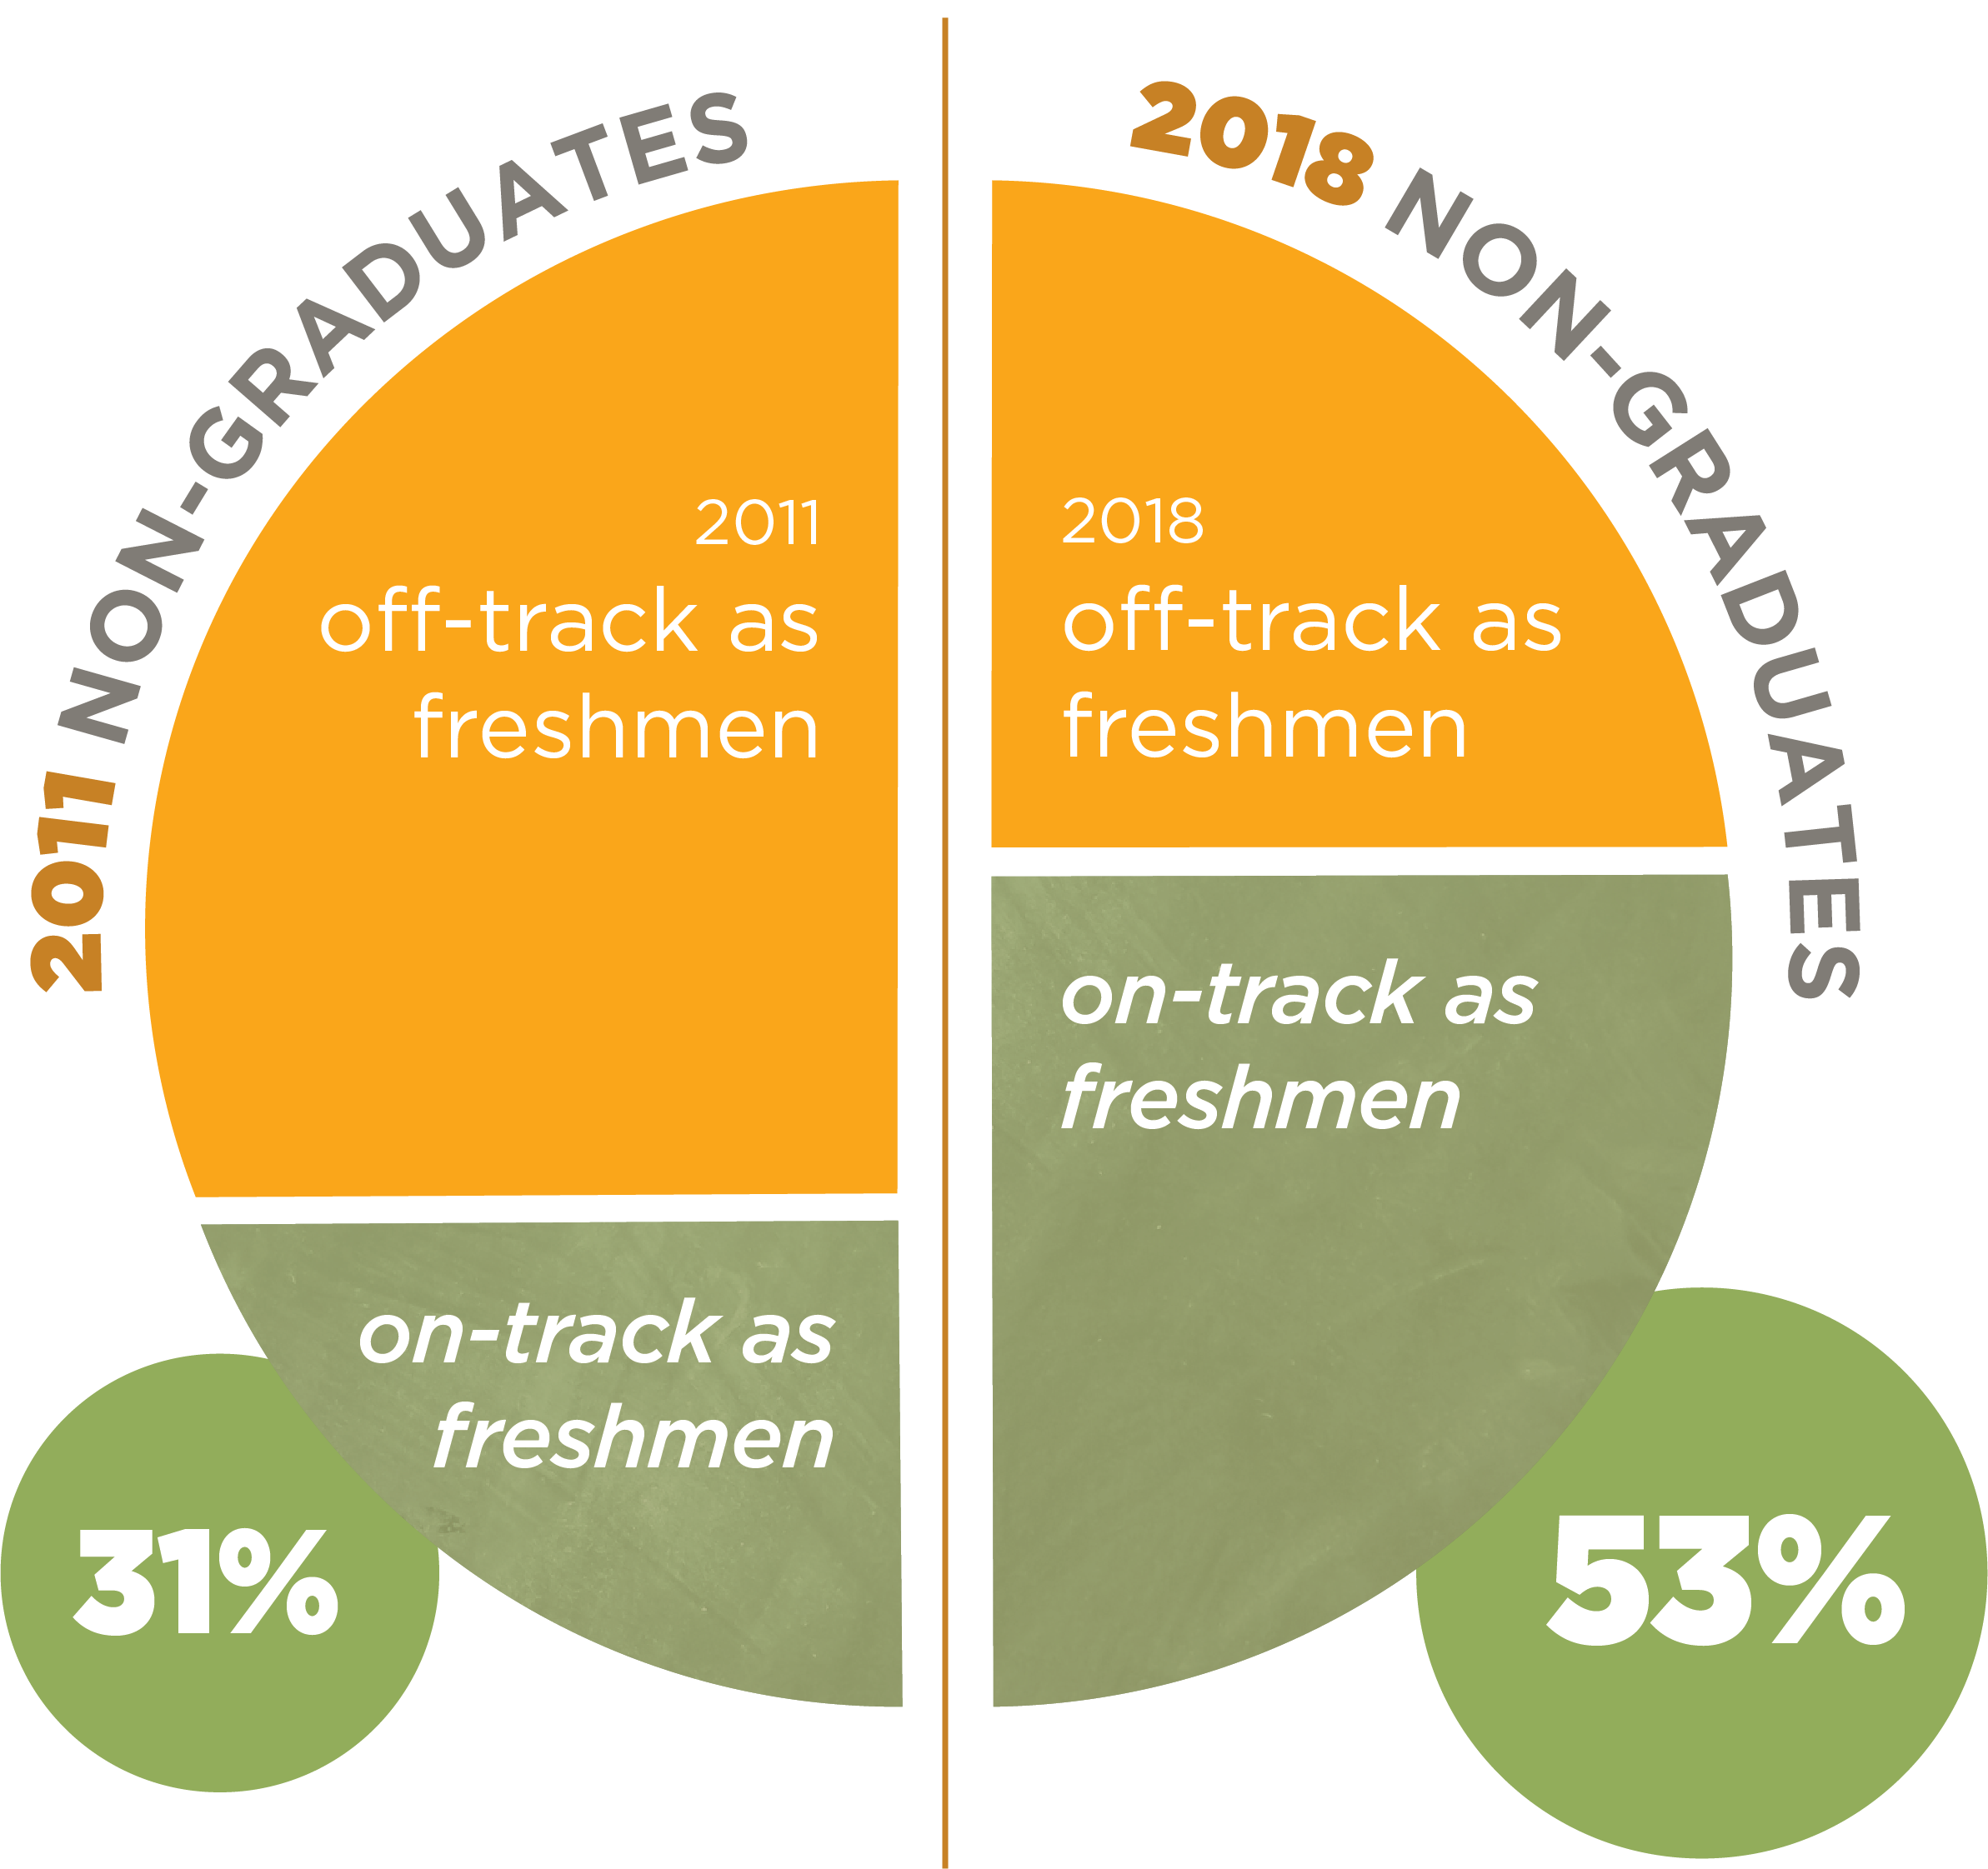
Among the remaining students who did not graduate from high school within four years, a higher proportion were on-track as freshmen.
Non-graduates are defined here as CPS students who did not graduate within four years of starting high school. Among the 6,663 non-graduates in 2011, 2,083 were on-track as freshmen. Among the 3,720 non- graduates in 2018, 1,989 were on-track as freshmen. Charter school students are excluded from this analysis.

Slide 8
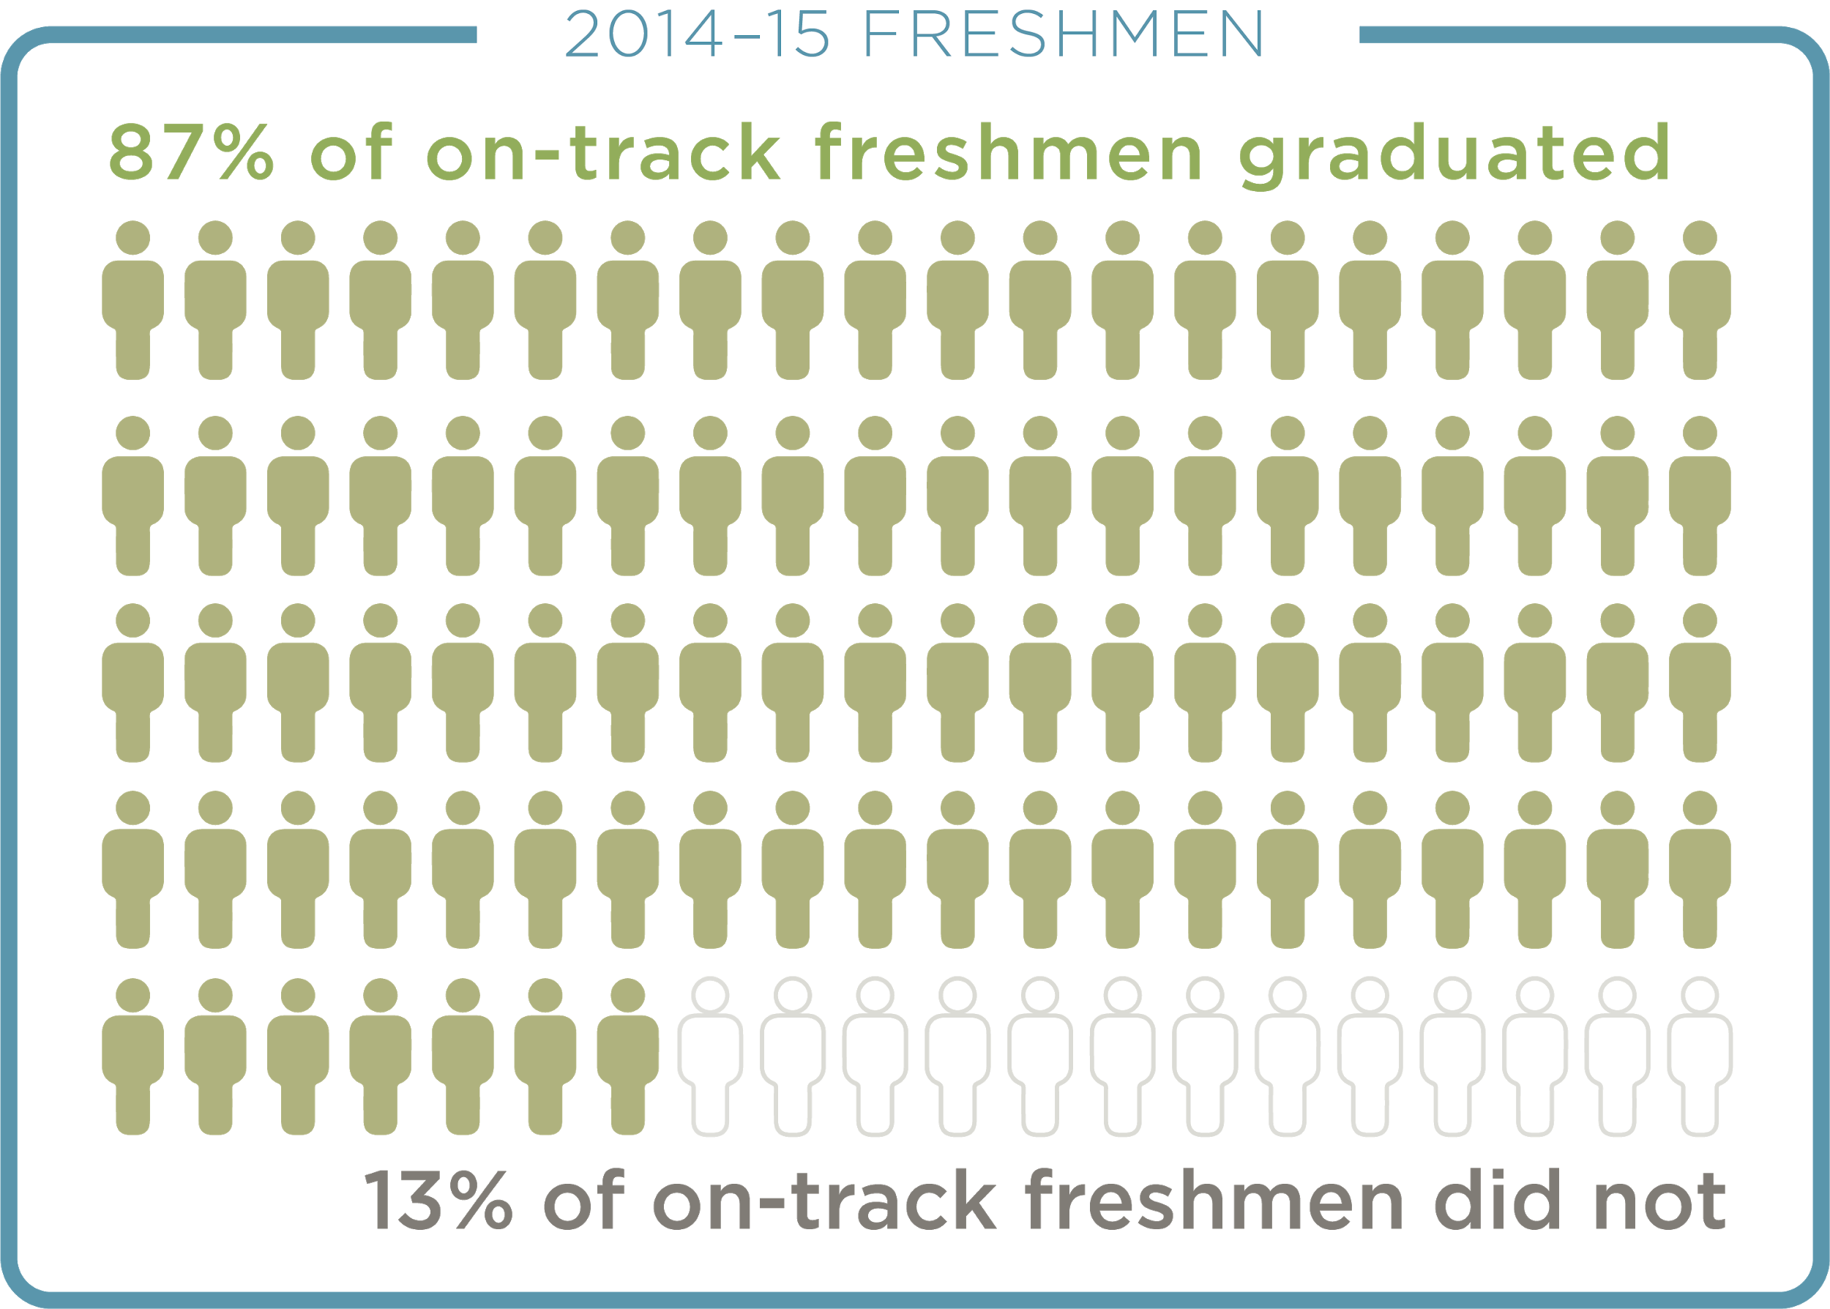
Not all students who finished freshman year on-track graduated from high school.
Charter school students are excluded from this analysis. Graduation status is based on whether a student graduated from CPS within four years of starting high school.

Slide 9
Lessons from Freshman Success
Not all students who finished freshman year on-track graduated from high school.
Fewer students were off-track as freshmen and more students graduated every year.
Still, in every cohort, there have been students who were on-track as freshmen but did not graduate. This suggests an opportunity to shift some of the focus to students who are on-track at the end of freshman year, but may require supports or interventions during sophomore year to graduate from high school.

Slide 10
The “Forgotten”
Sophomore Year

Slide 11
CPS defines Sophomore OnTrack similarly to Freshman OnTrack.
To be on-track, sophomores must fail no more than one semester of a core course during sophomore year and must accumulate 11 total credits by the end of sophomore year—enough to be promoted to the eleventh grade.
*English, math, science, and social studies.
Failures are counted by semester, and a yearlong one-credit course has two semesters. At CPS, students need at least 11 high school credits to be promoted to the eleventh grade.
Notes:
Define FOT verbally

Slide 12
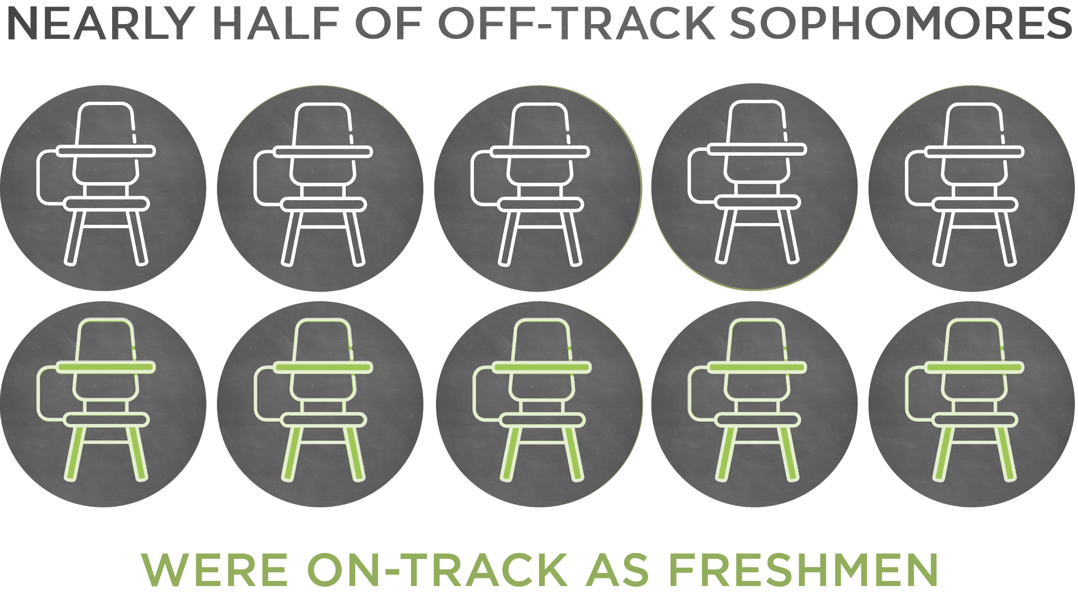
Rates of course failure increased in every subject between freshman and sophomore year.
Rates of course failure increased in every subject between freshman and sophomore year. This suggests a need to better monitor and support sophomore students.
Of the 3,147 students in the 2013–2014 freshman cohort who were off-track at the end of sophomore year, 1,542 (49 percent) were on-track as freshmen. Only students who were freshmen at CPS are included in sophomore analysis. Charter students are also excluded.

Slide 13
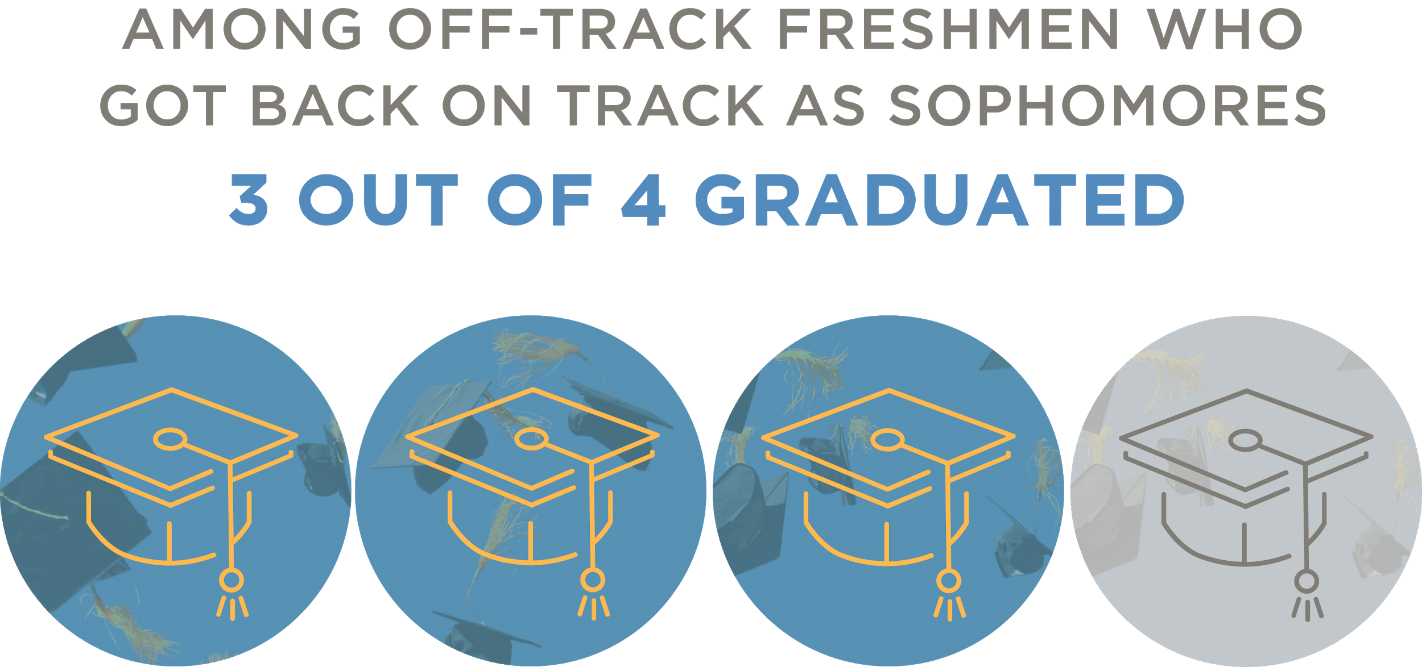
For freshmen who were off-track, sophomore year can be a time to recover.
Students who finished freshman year off-track but got back on-track sophomore year graduated at a rate similar to the district’s overall high school graduation rate.
This rate includes sophomores who were first-time freshmen during the 2013–2014 academic year. Only students who were freshmen at CPS are included in sophomore analysis. Charter students are also excluded.
Notes:
Size of the group
Comparison to other groups
Model movement from brief to report

Slide 14
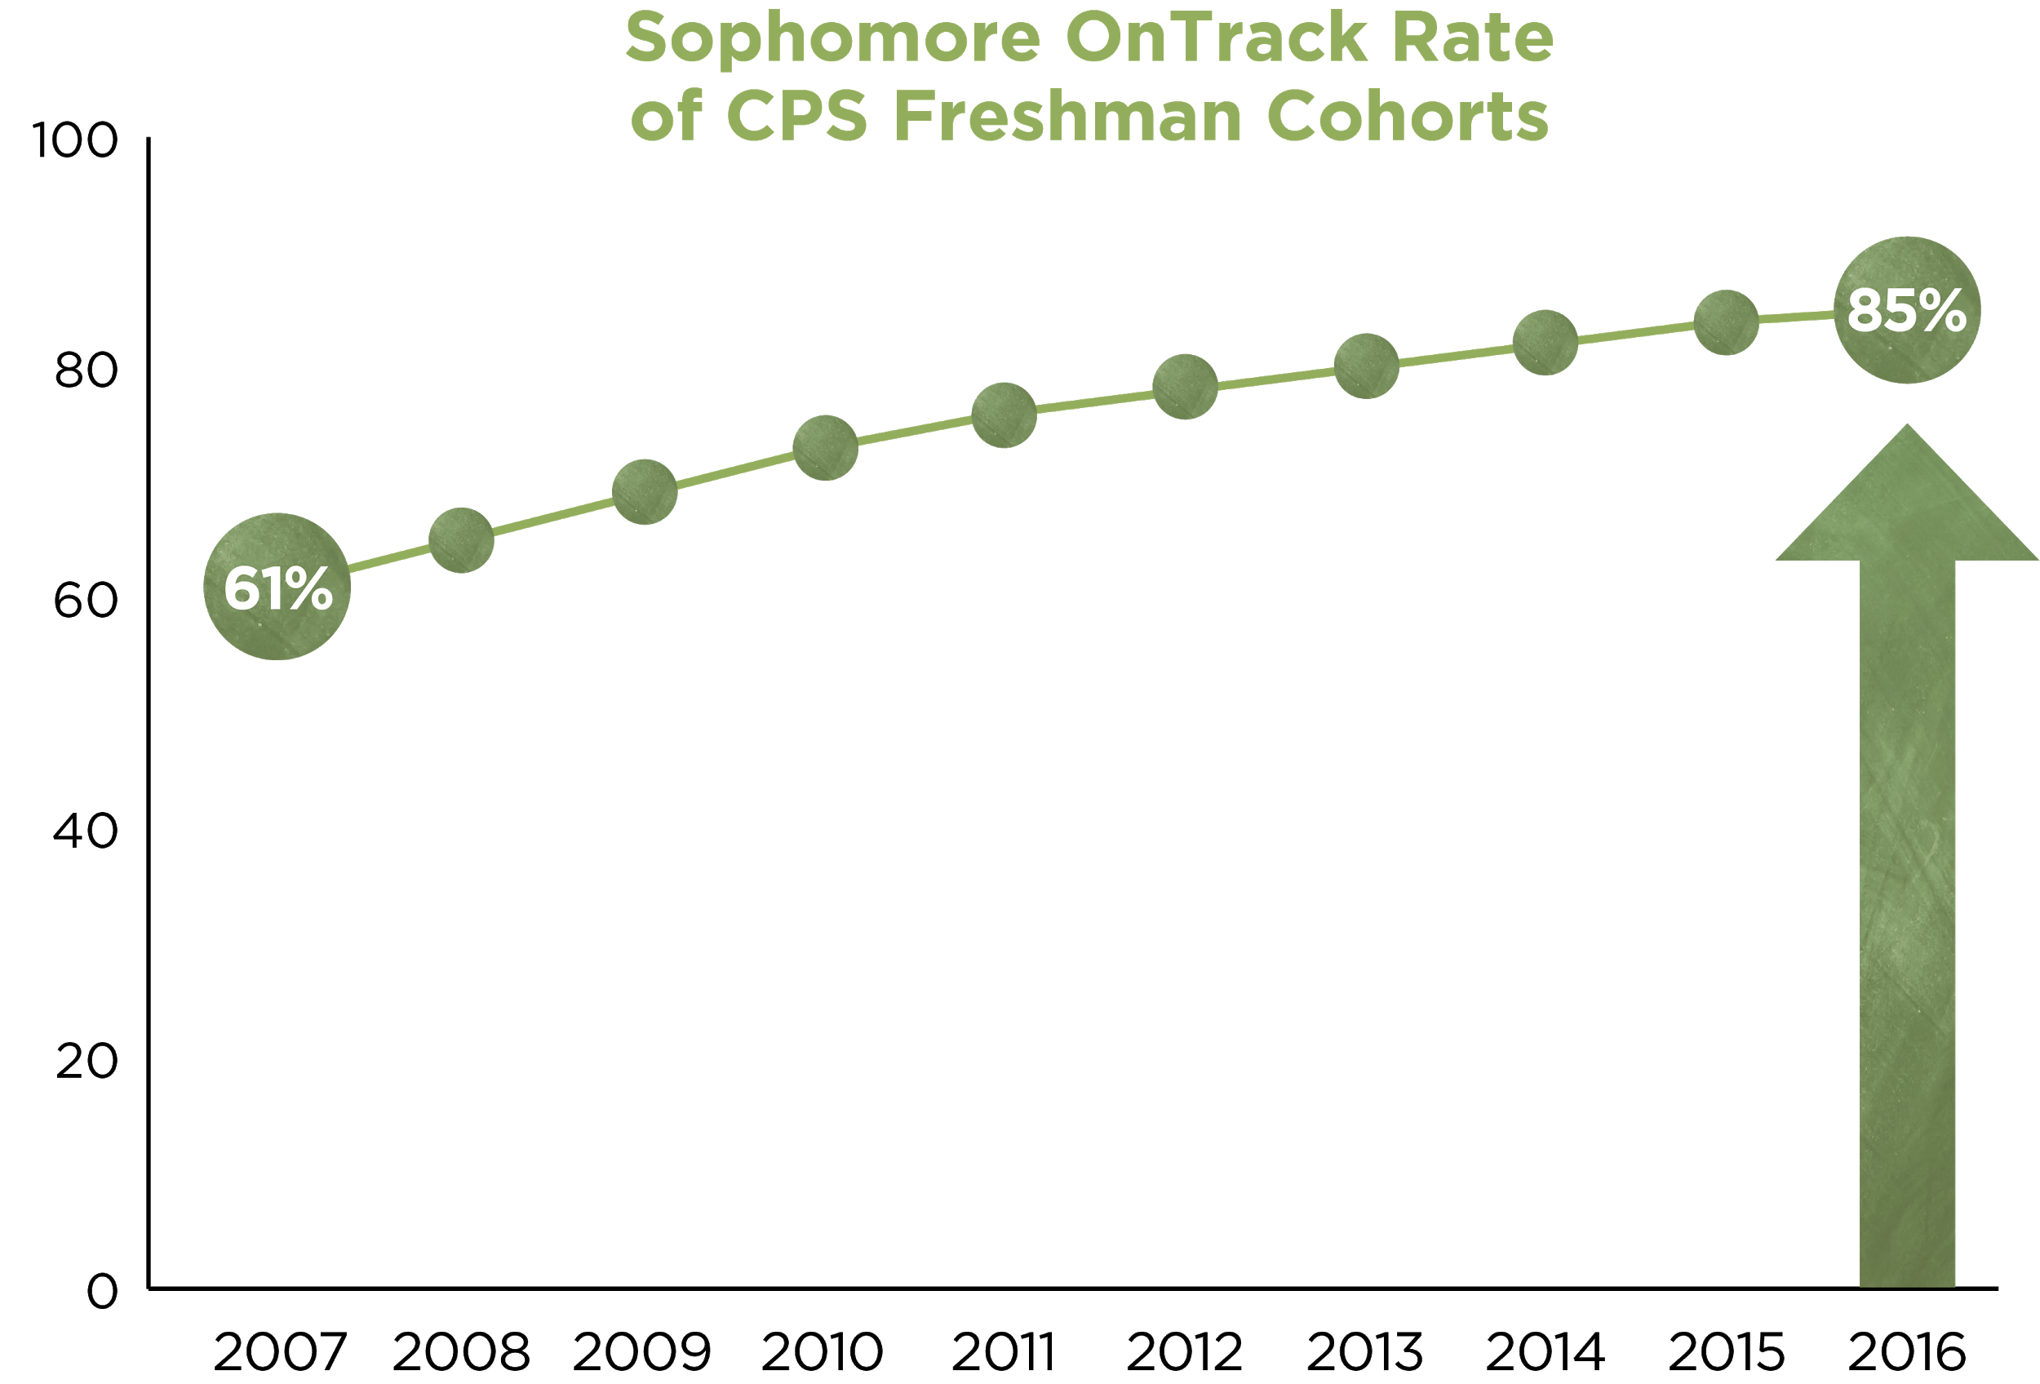
Sophomore OnTrack rates at Chicago Public Schools have increased over time.
As the CPS district and schools have invested heavily in intentional work around supporting their students as freshmen, they have seen significant gains in their students’ sophomore performance.
Freshman cohorts are labelled based on the fall of students’ first-time freshman year at CPS. Only students who were freshmen at CPS are included in sophomore analysis. Charter students are also excluded.

Slide 15
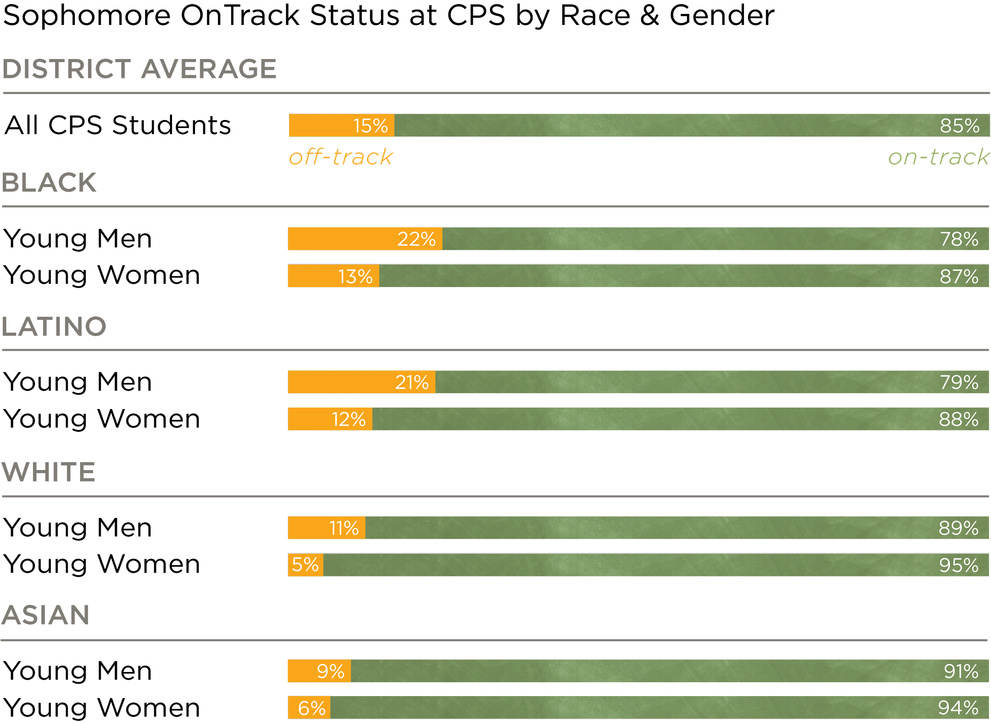
Not all students received the supports that they needed to be successful during sophomore year.
Disparities in students’ performance during sophomore year persist despite improvements in the district’s overall Sophomore OnTrack Rate. Notably, more than 20 percent of Black and Latino young men were off-track as sophomores.
Rates include sophomores who were first-time freshmen during the 2016–2017 academic year. Only students who were freshmen at CPS are included in sophomore analysis. Charter students are also excluded.

Slide 16
Integrating Indicators of High School and
College Success

Slide 17
Integrating Indicators of High School and College Success
Like Freshman OnTrack, Sophomore OnTrack is a powerful but limited indicator of high school outcomes. A student’s Sophomore OnTrack status reflects important information about their likelihood of graduating from high school, but may not reflect other important changes, such as low attendance and course failures.
At the beginning of sophomore year, nearly 70 percent of non-graduates could have been identified as needing additional support, based on their freshman performance, using three warning indicators.
By the end of sophomore year, an even larger proportion of non-graduates could have been identified, based on their sophomore performance, using the same three warning indicators.

Slide 18
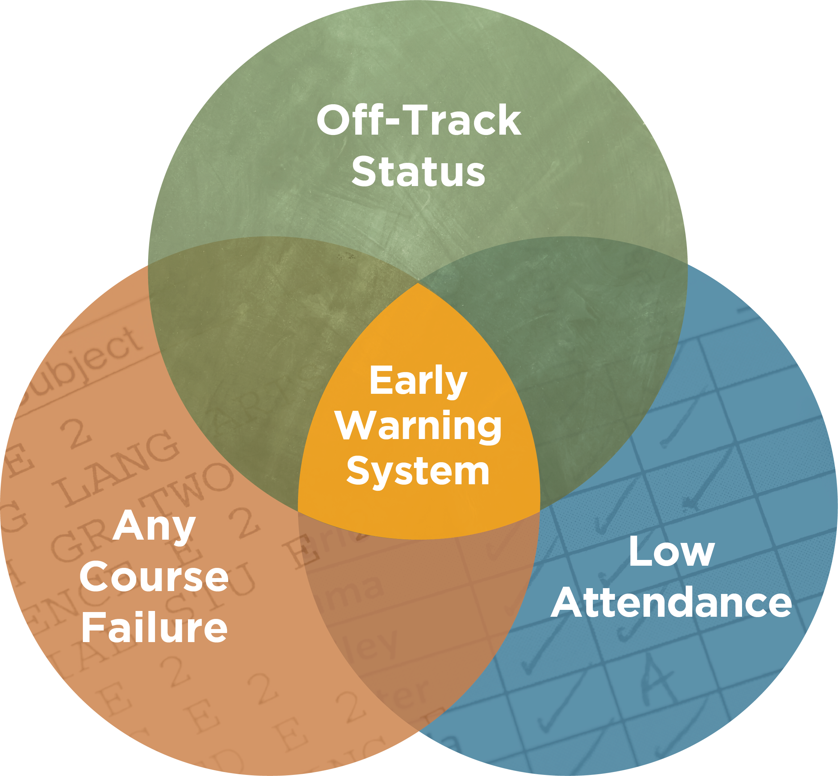
Sophomore educators can identify students who need extra support using three key early warning indicators.
Off-track status, course failures, and attendance are powerful warning indicators for high school graduation, but GPA is the most powerful indicator of college access and enrollment.
Even if a student fails just one semester of any course, it is considered a course failure. Low attendance is here defined as an attendance rate below 85 percent.

Slide 19
Sophomore educators can identify students who need extra support using three key early warning indicators.
By using a system that combines all of these key predictive indicators—a GPA threshold of 3.0, in addition to the three warning indicators for high school graduation—sophomore educators could further differentiate among their students to better identify potential challenges, and more effectively target supports.

Slide 20
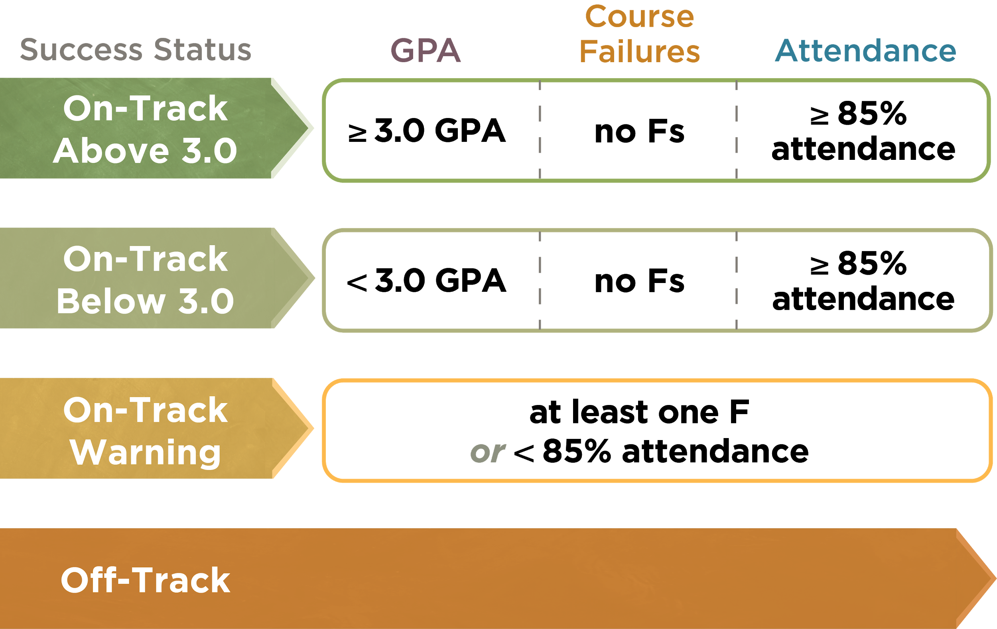
By monitoring GPA, course failures, and attendance, educators can identify additional students who need support.
These success status groups can be applied at the beginning of sophomore year, using freshman year performance data, and throughout sophomore year, using sophomore year performance data.

Slide 21
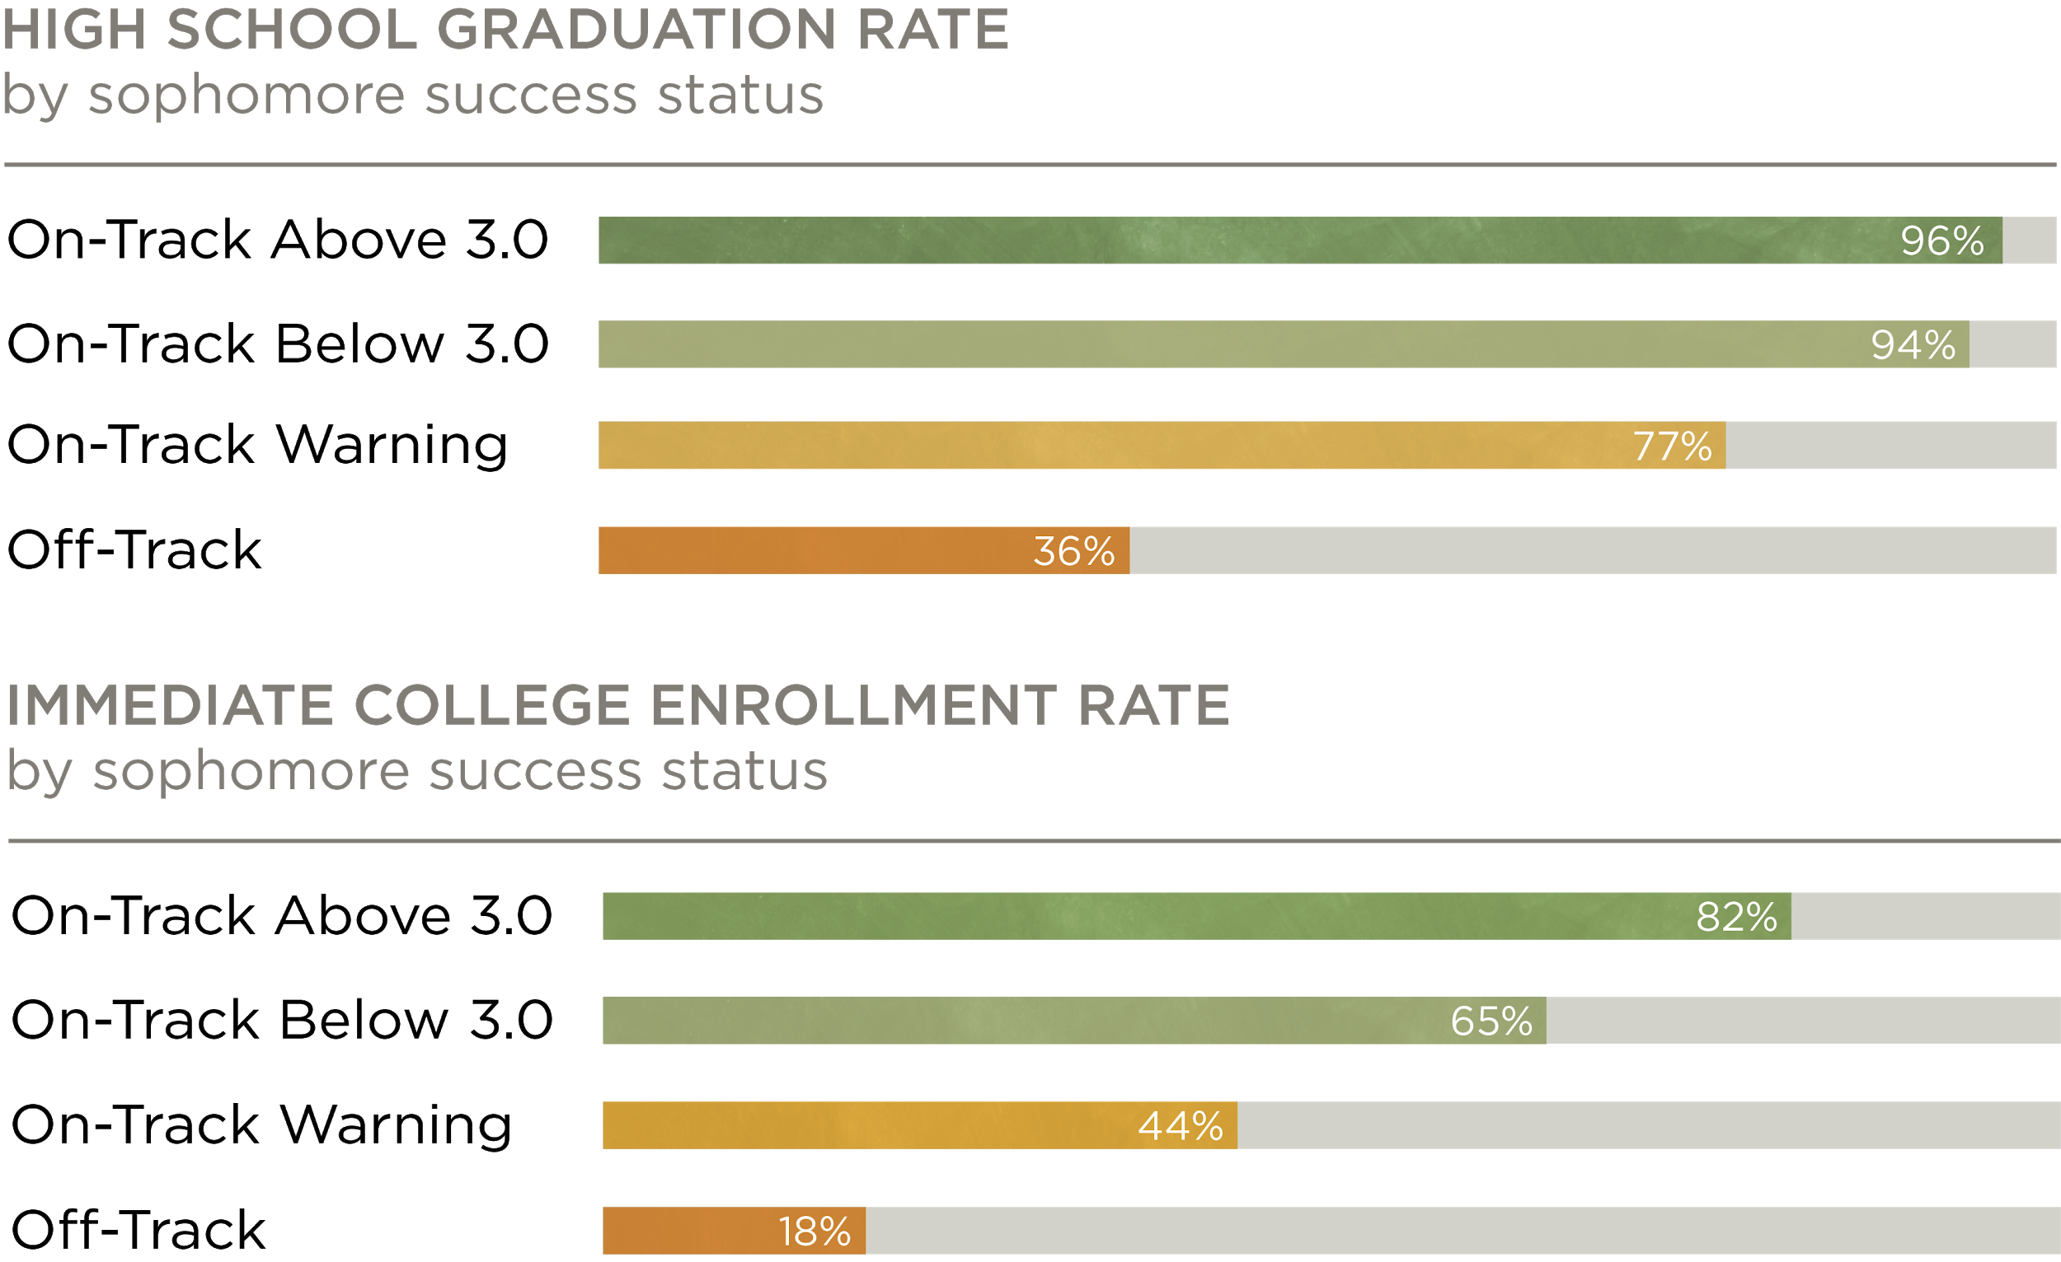
Sophomores in the On-Track Warning group were less likely than other on-track students to graduate and to enroll in college.
Earning a GPA above 3.0 during sophomore year is an important indicator of students’ likelihood of enrolling in college. While sophomores in the On-Track Below 3.0 group graduated from high school at a high rate, they enrolled in college at a lower rate than their peers with at least a 3.0 GPA as sophomores.
The rates depicted are for students who were first-time freshmen during the 2013–2014 academic year. GPA is not cumulative. Only students who were freshmen at CPS are included in sophomore analysis. Charter students are also excluded.

Slide 22
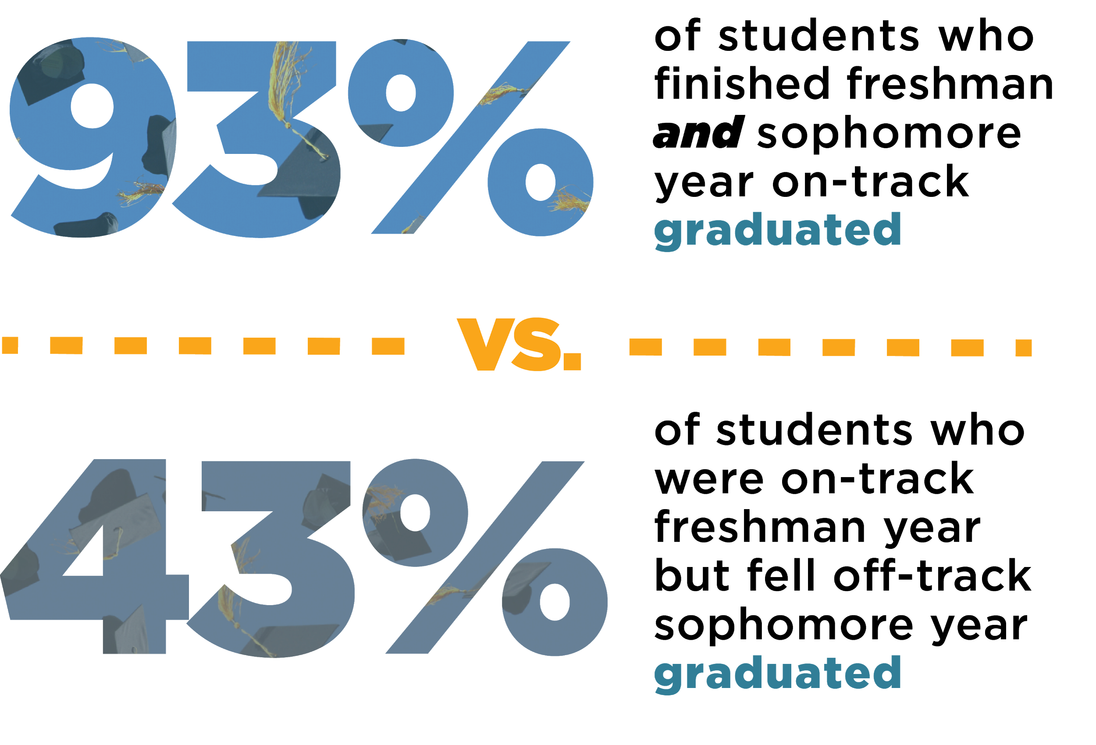
Freshman and sophomore success matter for high school graduation.
The rates depicted include students who were first-time freshmen during the 2013–2014 academic year. Only students who were freshmen at CPS are included in sophomore analysis. Charter students are also excluded. Graduation status is based on whether a student graduated from CPS within four years of starting high school.

Slide 23
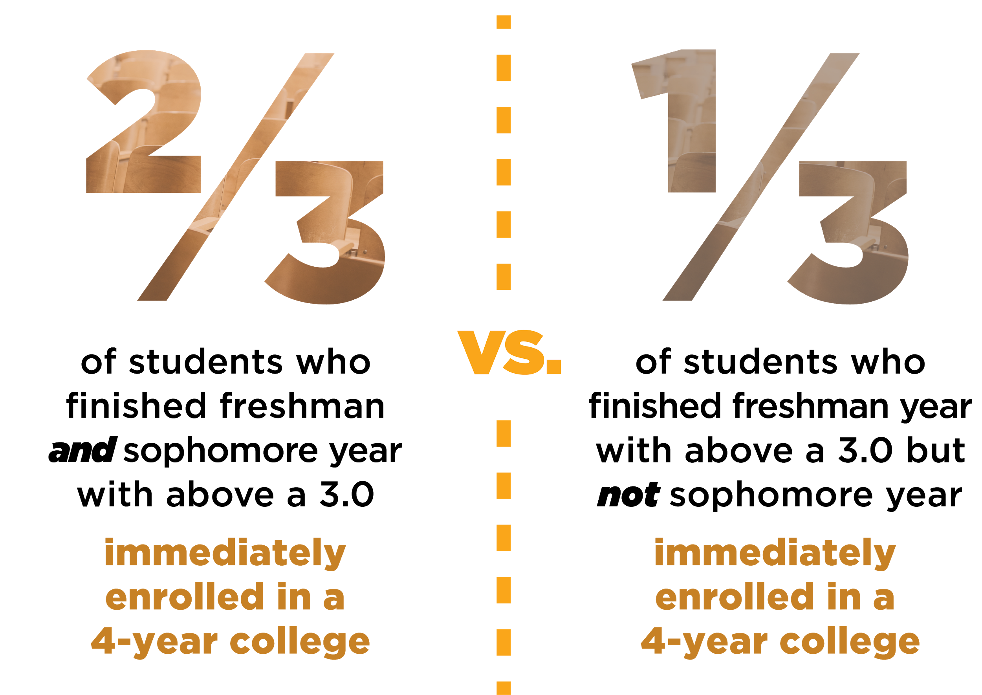
Students with a 3.0+ GPA freshman and sophomore year were most likely to immediately enroll in a 4-year college.
The rates depicted include students who were first-time freshmen during the 2013–2014 academic year. Only students who were freshmen at CPS are included in sophomore analysis. Charter students are also excluded.

Slide 24
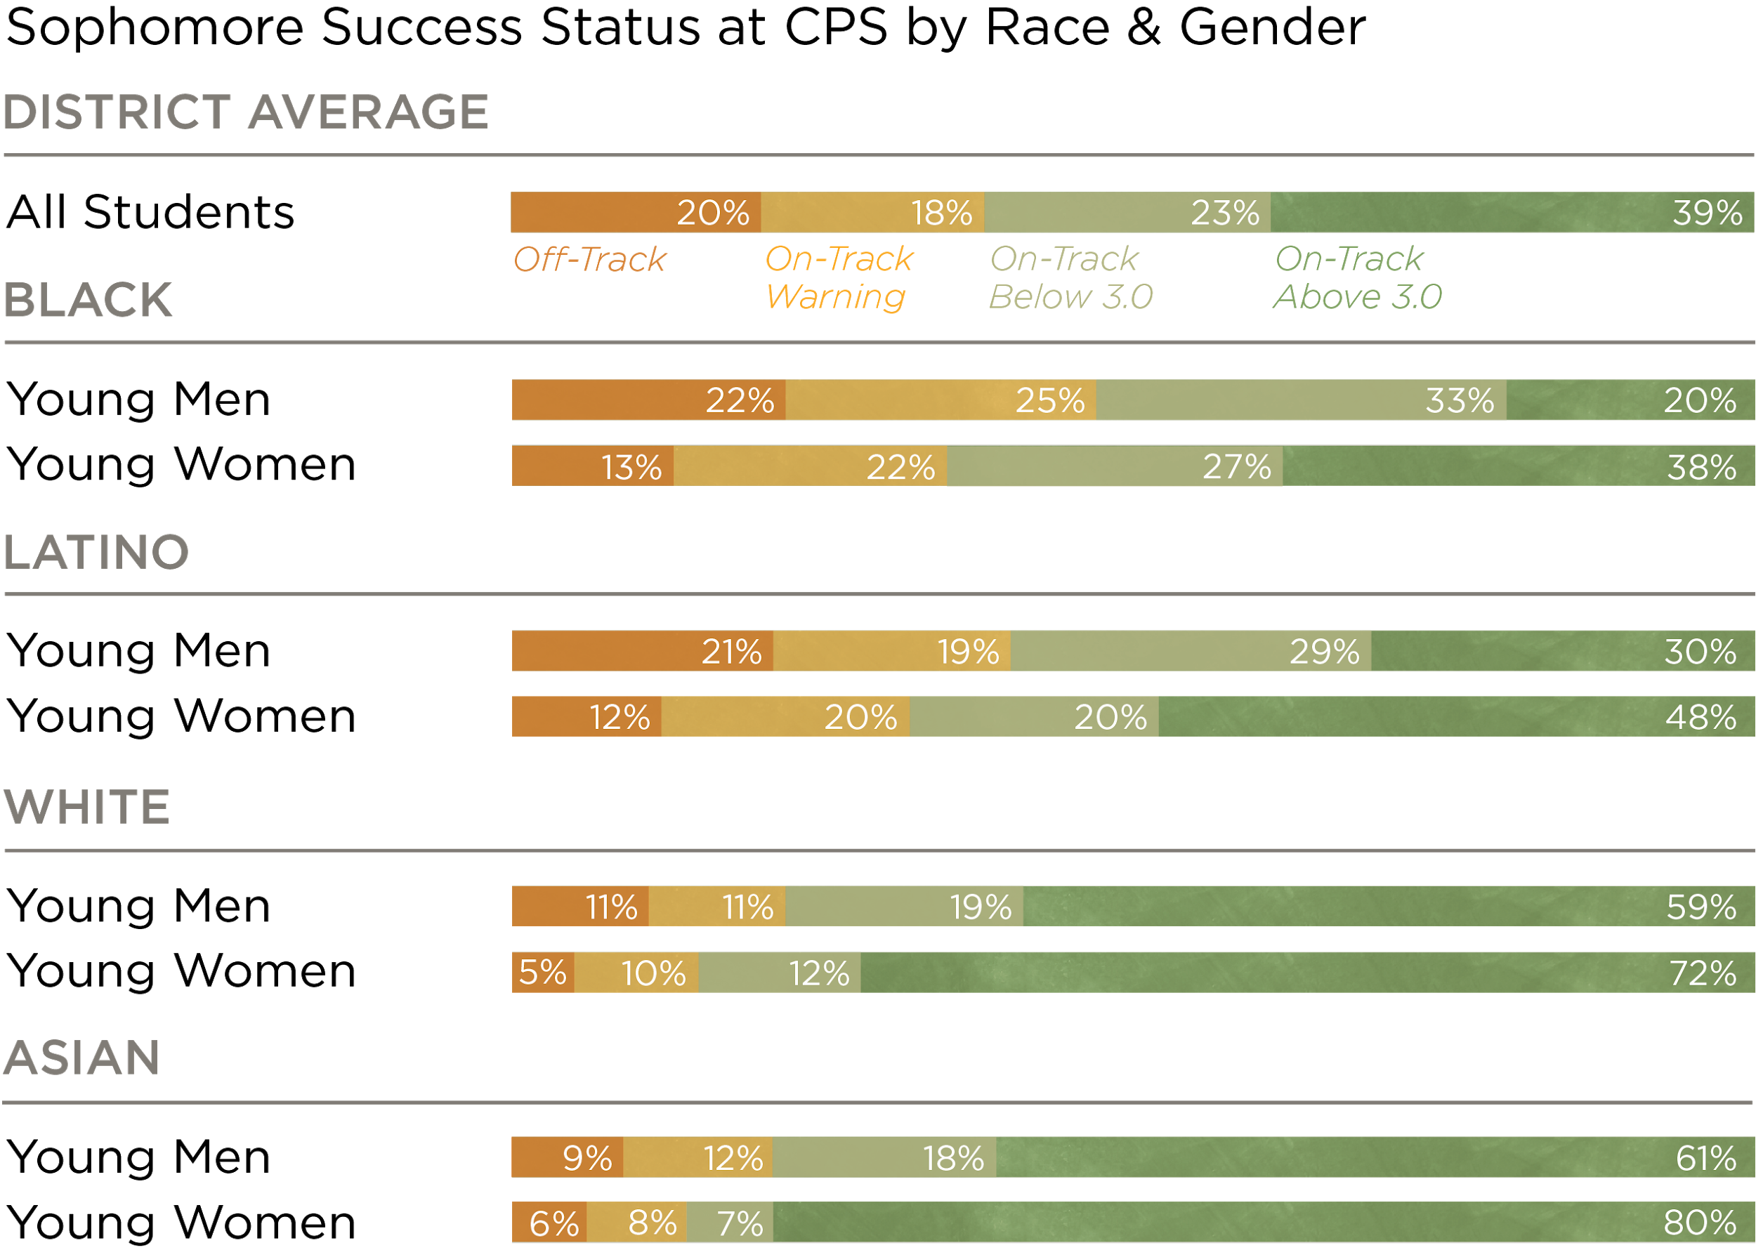
Black and Latino young men were less likely than their peers to be on-track with above a 3.0 GPA by the end of their sophomore year.
If Black and Latino young men aren’t getting the supports that they need to be successful during the first two years of high school, they will not have access to as broad a range of post-secondary opportunities as their peers.
Rates include sophomores who were first-time freshmen during the 2016–2017 academic year. GPA is not cumulative. Percentages may not add up to 100 due to rounding. Only students who were freshmen at CPS are included in sophomore analysis. Charter students are also excluded.

Slide 25
Black and Latino young men were less likely than their peers to be on-track with above a 3.0 GPA by the end of their sophomore year.
A 3.0 GPA has critical implications for students’ access to selective and highly-selective colleges and other post-secondary pathways. Fewer than one-third of Black young men and Latino young men earned above a 3.0 GPA during their sophomore year, highlighting that not all students are receiving the supports that they need to be successful during sophomore year.

Slide 26
Key Takeaways

Slide 27
Key Takeaways
Freshman year remains the most critical year in students’ educational trajectories. Even with rising Freshman OnTrack rates, Freshman OnTrack remains predictive of high school graduation.
For students who were off-track during freshman year, sophomore year can be an opportunity to recover. For some students who were on-track during freshman year, sophomore year can be a time of significant risk.
Sophomore year presents educators with an additional opportunity to identify and intervene with students who need more support. By monitoring low attendance rates and all course failures, educators can provide support to a wider group of students in danger of not graduating or enrolling in college.

Slide 28
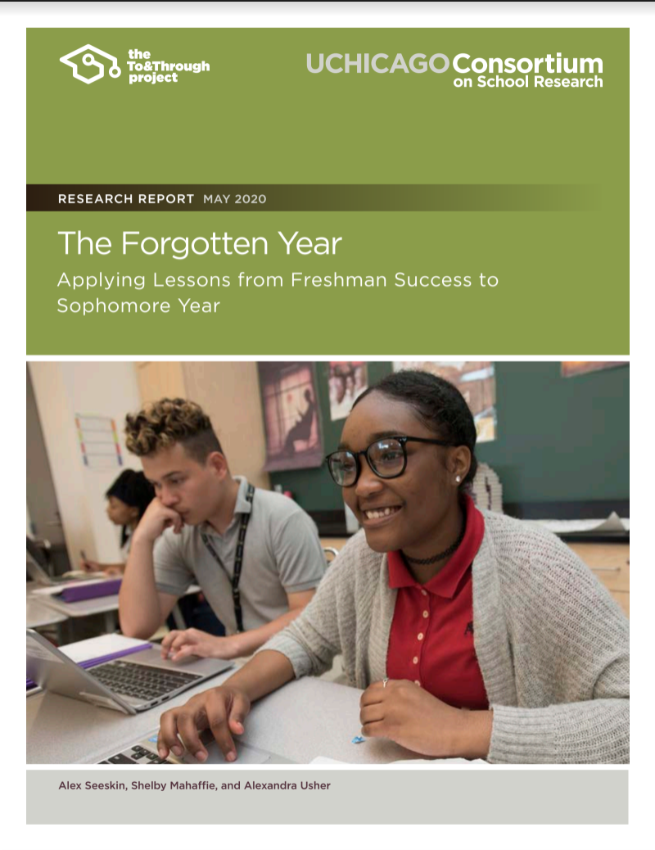
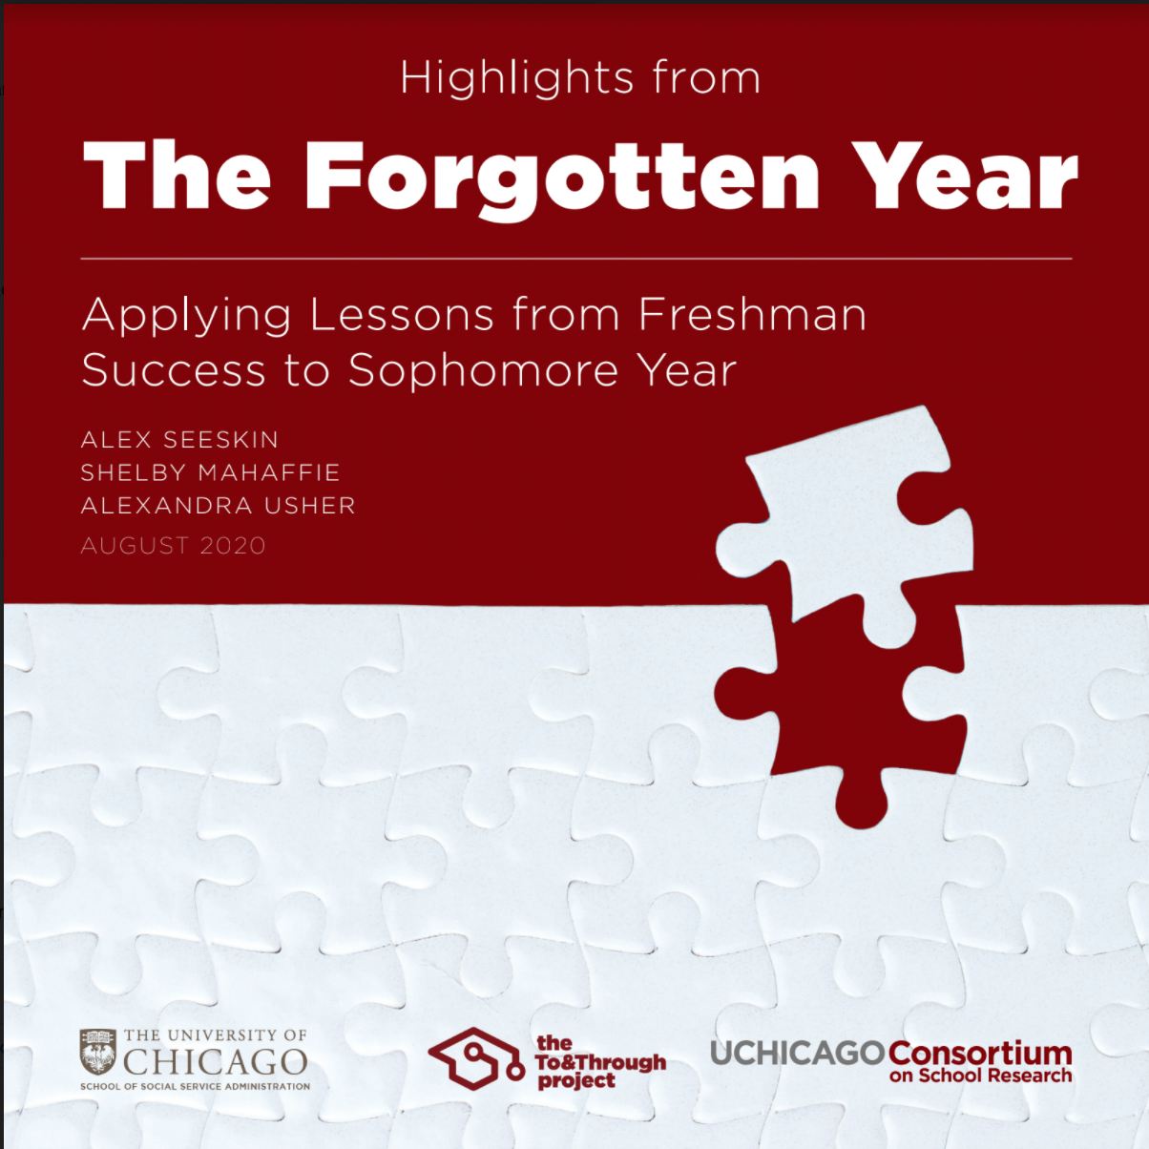
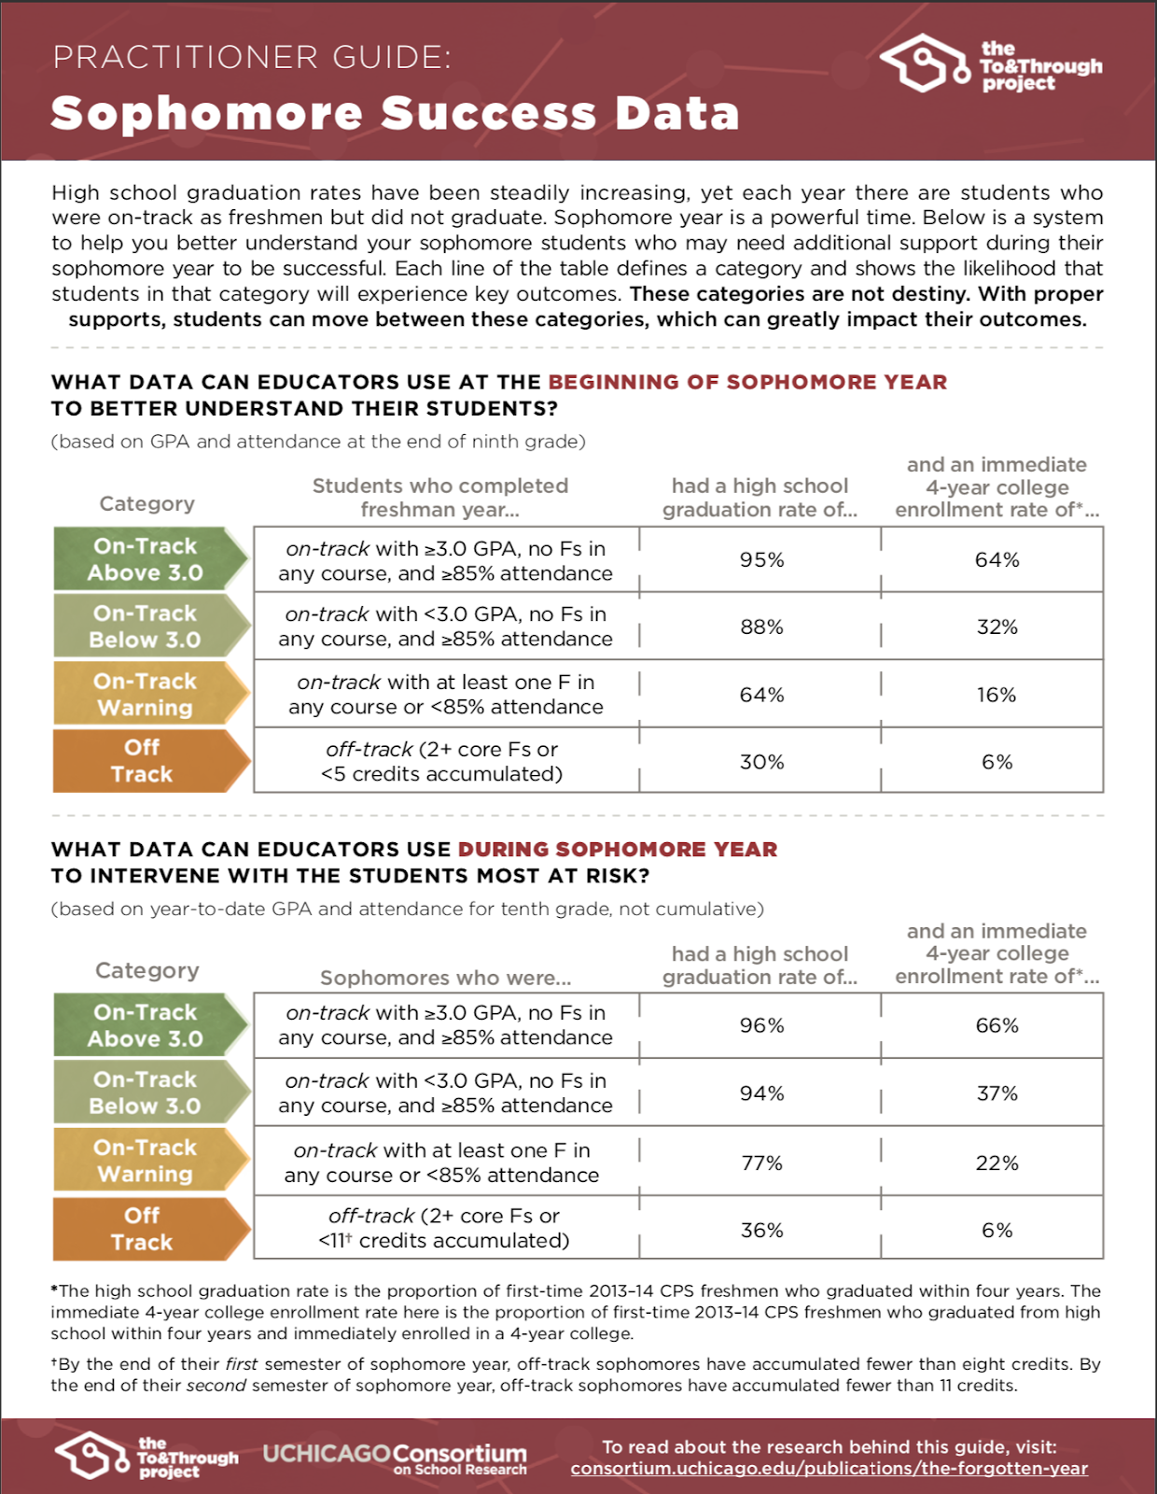
Download the Report, Booklet, & Practitioner Guide
To download and share the report, booklet, or practitioner guide, please visit consortium.uchicago.edu/publications/the-forgotten-year

