Slide 1
What Does “On-Track” Mean?
D
Communicating On-Track Research to Staff, Students, and Families
A presentation that introduces the On-Track metric to students as well as emphasizing the importance of attendance and grades in freshman year.

Slide 2
What Does “On-Track” Mean?
“On-Track” Series Guidance Curriculum – Academic Domain
Al Raby High School 2009-2010

Slide 3
Communicating On-Track Research to Staff, Students, and Families
Who wants to go to college?
Why?
What difference does going to college make?

Slide 4
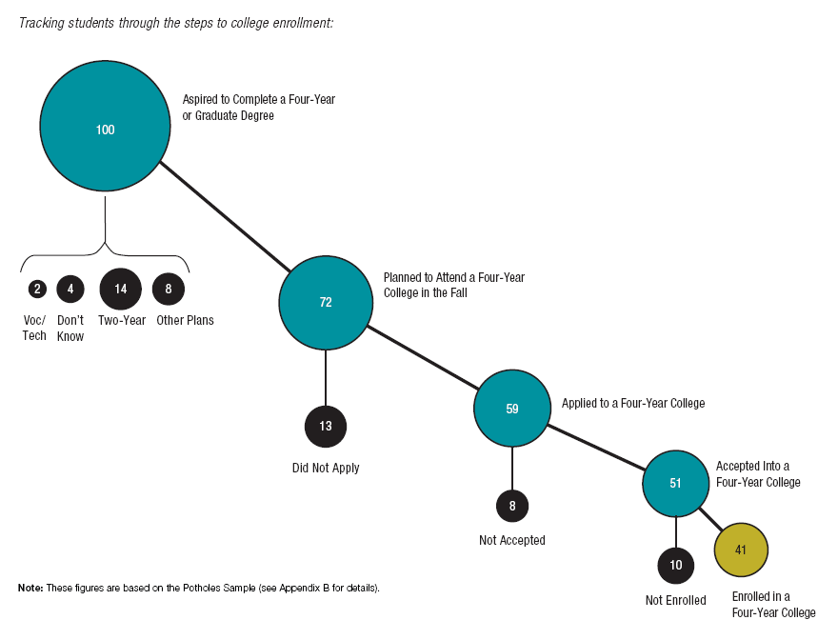
Communicating On-Track Research to Staff, Students, and Families

Slide 5
Communicating On-Track Research to Staff, Students, and Families
So how do I make sure I graduate?
Know your destination (college) and keep it in sight
Have a roadmap (a plan for how to get there)
Ask for directions when needed
Stay ON TRACK!

Slide 6
Communicating On-Track Research to Staff, Students, and Families
What does “On-Track” mean?
On-Track means you are performing in a manner that will allow you to graduate in four years
Must earn at least 5 credits by June of freshman year
Fail no more than .5 of a core course credit (one semester of a core class)
(Core Courses = Survey Literature, World Studies, Environmental Science, Algebra)

Slide 7
Communicating On-Track Research to Staff, Students, and Families
Did you know…
3.5 X
An “On-Track” freshman is
than an off-track freshman.
MORE LIKELY
TO GRADUATE IN 4 YEARS

Slide 8
Communicating On-Track Research to Staff, Students, and Families
How do I stay On Track?
Pass all classes
Attend school every day
Know the requirements for graduation

Slide 9
Communicating On-Track Research to Staff, Students, and Families
Graduation Requirements at Al Raby High School
24 credits (minimum)
4 service learning projects, to be completed through your academic classes each year
4 years of student advisory
Driver’s Education (PE II)
PSAE (Prairie State Achievement Exam)
Public Law Exam
Consumer Education exam

Slide 10
Communicating On-Track Research to Staff, Students, and Families
Al Raby’s Graduation Requirements
English | 4 credits | 1. Survey of Literature* 2. World Literature* | 3. American Literature* 4. British Literature*
Math | 3 credits | 1. Algebra I* 2. Geometry* | 3. Algebra II/Trig.*
Science | 3 credits | 1. Environmental Sci. 2. Biology* | 3. Chemistry 4. Physics
Social Science | 3 credits | 1. World Studies* 2. US History* | 3. (see electives)
World Language | 2 credits | 1. Spanish I* 2. Spanish II*
Fine Arts | 2 credits | 1. Art* 2. General Music*

Slide 11
Communicating On-Track Research to Staff, Students, and Families
Al Raby’s Graduation Requirements (cont.)
Physical Education | 2 credits | 1. PE I/Health* 2. PE II/Driver’s Ed*
Career Education | 3 credits | AVID I, II, III, IV OR any course above and beyond the minimum requirement | English Senior Project*
Electives | 2 credits (choose from the following) | Beg. Mixed Chorus Collins Writing AP Psychology AP US Government AP Studio Art AP Environmental Sci. | Statistics Pre-Calculus AP Calculus AP Statistics AP Lang. & Comp. AP Literature
Total = 24 Credits *Required course

Slide 12
Communicating On-Track Research to Staff, Students, and Families
Speaking of credits, what are they?
1 semester class passed = ½ credit
So, if you pass every class during the semester, you can earn how many credits?
6 classes x ½ credit each =
3 credits at the semester
6 credits per school year

Slide 13
Communicating On-Track Research to Staff, Students, and Families
Speaking of credits, what are they?
5 Week Mark: Progress Report
20 Weeks: Semester 1 Report Card
½ credit for each class passed!
10 Week Mark: Quarter 1 Report Card
15 Week Mark: Progress Report

Slide 14
Communicating On-Track Research to Staff, Students, and Families
Is this student On Track?
 | 1st Semester | 2nd Semester
Survey Lit. | B | B
Algebra | C | A
Env. Science | D | D
World Studies | B | C
PE/Health | A | A
Art I | B | B
Reading | B | C
YES

Slide 15
Communicating On-Track Research to Staff, Students, and Families
Is this student On Track?
 | 1st Semester | 2nd Semester
Survey Lit. | C | C
Algebra | B | C
Env. Science | D | C
World Studies | F | F
PE/Health | A | A
Art I | A | B
Reading | C | D
NO

Slide 16
Communicating On-Track Research to Staff, Students, and Families
Is this student On Track?
 | 1st Semester | 2nd Semester
Survey Lit. | C | C
Algebra | F | D
Env. Science | C | C
World Studies | C | B
PE/Health | A | A
Art I | A | A
Reading | D | C
YES

Slide 17
Attendance Matters!!!

Slide 18
Communicating On-Track Research to Staff, Students, and Families
Attendance Matters!!!
Research shows that students who attend school each day:
Get better grades
Learn more
Are more likely to get high school diplomas
Are less likely to go to prison

Slide 19
Communicating On-Track Research to Staff, Students, and Families
Fact:
Nearly 90% of freshmen
who miss less than 1 week of school per semester
GRADUATE FROM HIGH SCHOOL
regardless of their 8th grade test scores.

Slide 20
Communicating On-Track Research to Staff, Students, and Families

Slide 21
Communicating On-Track Research to Staff, Students, and Families
Attendance Matters!
List 3 reasons why students are absent and tardy to school
List solutions for each reason

Slide 22
Communicating On-Track Research to Staff, Students, and Families
Attendance Matters!
What time are students expected to be at school?
Where is the attendance office located?
What is an excused absence?
What is an unexcused absence?
What are the consequences?

Slide 23
Communicating On-Track Research to Staff, Students, and Families
Check Points
October 14 | Progress Report 1
November 19 | Report Card 1 (Pick-up)
December 16 | Progress Report 2
February 3 | Report Card 2
END OF 1ST SEMESTER
March 10 | Progress Report 3
April 22 | Report Card 3 (Pick-up)
May 19 | Progress Report 4
June 18 | Report Card 4
END OF 2ND SEMESTER

Slide 24
Communicating On-Track Research to Staff, Students, and Families
How do I stay On Track?
Pass all classes
Attend school every day
Know the requirements for graduation
What are some possible consequences of falling off track in freshman year?

Slide 25
Communicating On-Track Research to Staff, Students, and Families
Remember!

Slide 26
Communicating On-Track Research to Staff, Students, and Families
Al Raby’s Goal!
100%
100%
% of Raby students who aspire to complete a 4-year degree
% of Raby students who succeed in completing a 4-year degree

Slide 27
Stay On Track!

